Slide 1


database for medical laboratory system.
Sarah Yaser 221001902
Mohamed Reda 221001846
Mohamed KHalf 222000072
Asmaa Ragb 221001773
DR. Mohamed ELSayeh

Slide 2




Introduction
This project aims to design and implement a database system for a medical laboratory. The goal of this project is to manage laboratorians, patients, medical tests, components, and test results

Slide 3

Tools Used
Database: SQL for creating tables, inserting data, and writing queries.
UI: Python (Tkinter) for creating a desktop
application for easy data management.

Slide 4

Entities and Attributes
Step 1:
we started by identifying the main entities :
laboratorian, patient, component, medical test, test result, and a linking table called test component. Each has its own relevant attributes

Slide 5
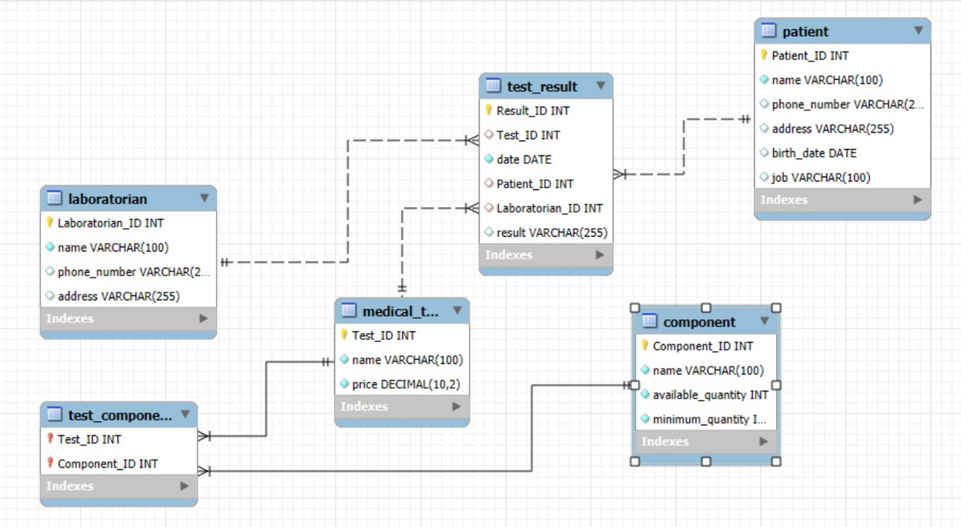
ER Diagram
Step 2:
The ER diagram shows how the entities are related.
One-to-Many between Laboratorian and Test Result
One-to-Many between Patient and Test Result
Many-to-Many between Medical Test and Component, managed through Test Component

Slide 6
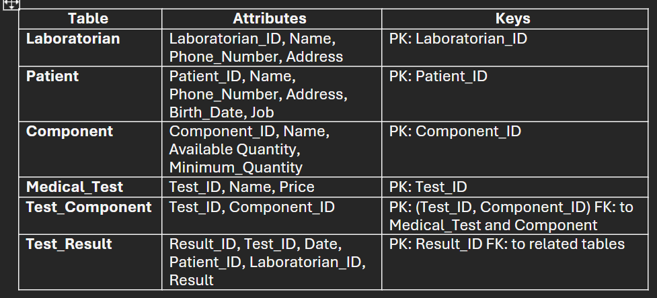
Relational Schema
Step 3:
Tanslated the ER diagram into a Relational Schema. Each table has a primary key, and foreign keys link related tables.
The test_component table uses a composite key to manage the many-to-many relationship

Slide 7
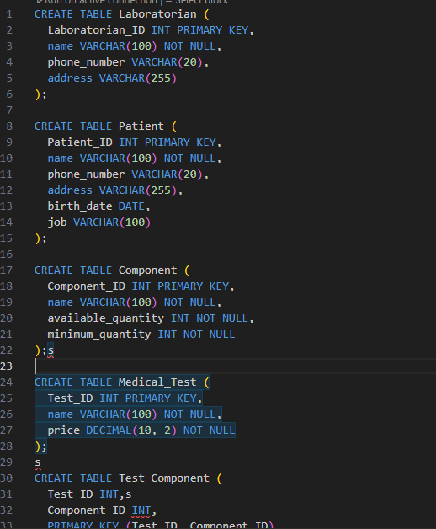
SQL Table Creation
Step 4:
Used SQL to create the tables. I included constraints like PRIMARY KEY, FOREIGN KEY, and NOT NULL to ensure data consistency
SQL Code Example for Laboratorian Table :

Slide 8
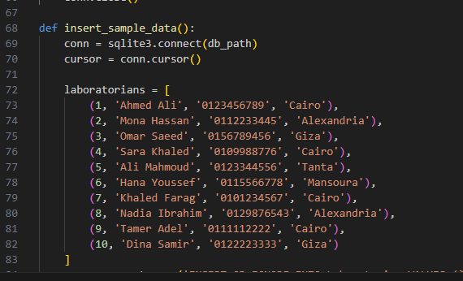
Inserting Sample Data
Step 5 :
Inserted 10 records into each table
to test the system.
This data simulates real-world operations and helps validate queries and relationships

Slide 9
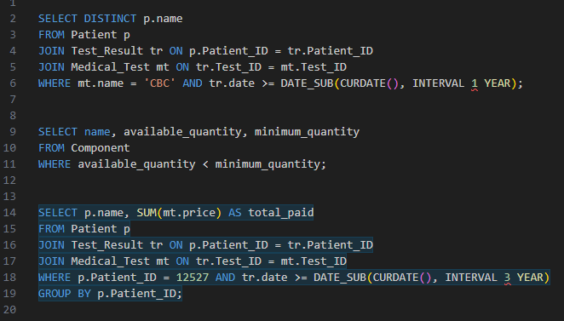
Example SQL Queries
Step 6 :
These queries help retrieve important data from the database .
Find Patients Who Took the CBC Test in the Last Year
Identifies patients who have taken the CBC test within the last year.
2.Find Components Below Minimum Quantity
Lists components that are below their required minimum quantity.
3.Calculate Total Amount Paid by a Patient in the Last 3 Years
Sums up the total amount spent by a specific patient on tests over the past 3 years.

Slide 10
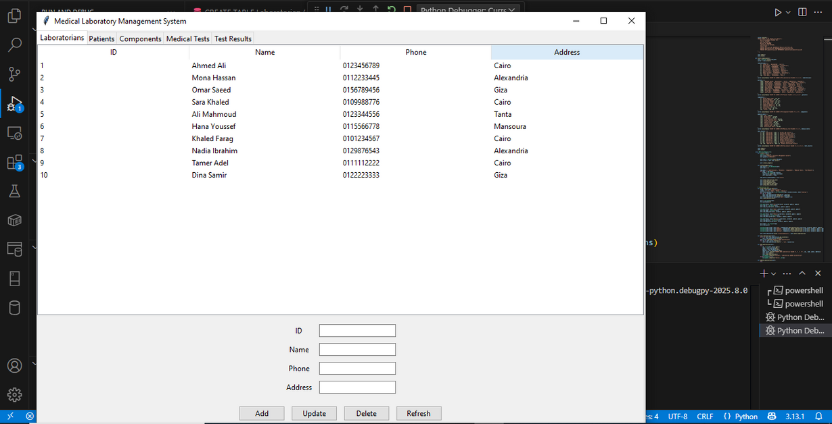
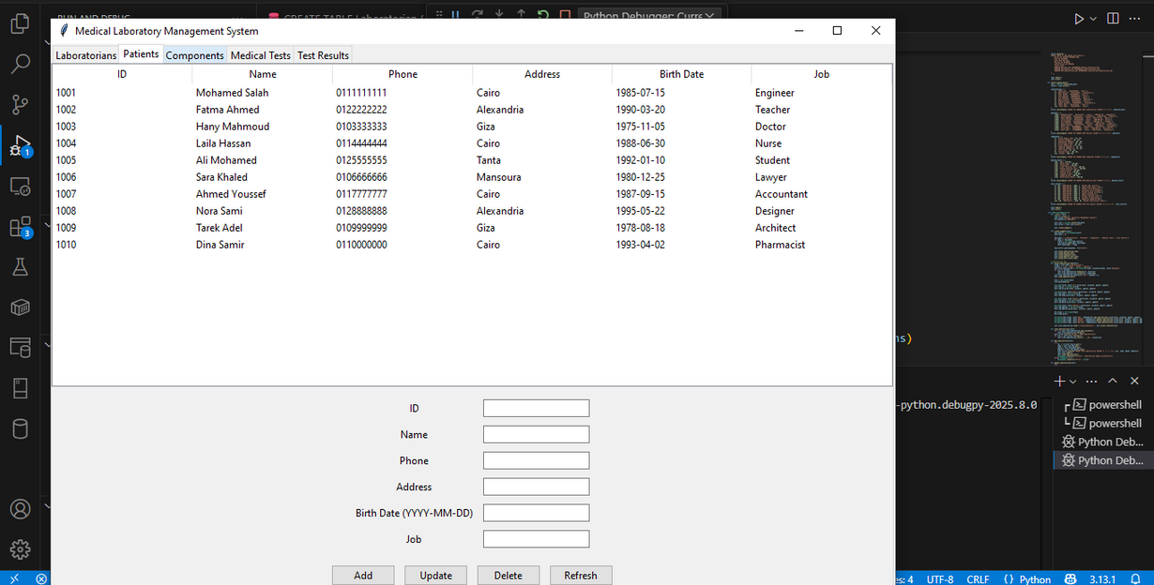
Application UI
Step 7 :
Built a Python desktop application using Tkinter. It connects to the database and allows users to add, update, delete, and view records through a simple interface

Slide 11
Application UI
Way to Run the App in VSCode
Install Python and Tkinter
2. Open VSCode and make sure you have the Python extension installed.
3. Download the medical_lab_app .py file.
4. Open it in VSCode.
5. Set Up the Database:
6.Run the App:

Slide 12

Explanation & Implementation
started with identifying entities, created the ER diagram and schema, wrote the SQL code, tested it with sample data, and then developed the application. This project helped me apply everything I learned in a real way
-

